Slide 1
CMPE 220
Class 2
Computer Architecture
Notes:
Let’s talk about history.
California State Railroad Museum – 1976 - docents worked on original steam engines.

Slide 2
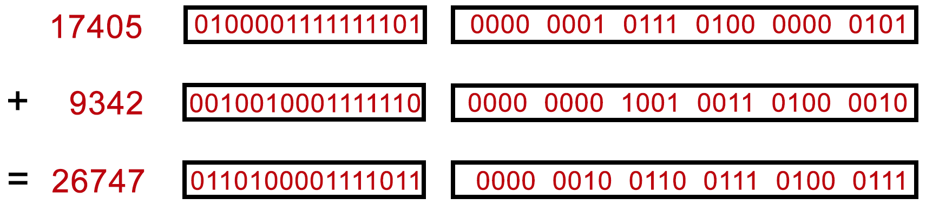
Binary Versus Decimal Arithmetic
Decimal
Binary
Binary Coded Decimal (BCD)

Slide 3
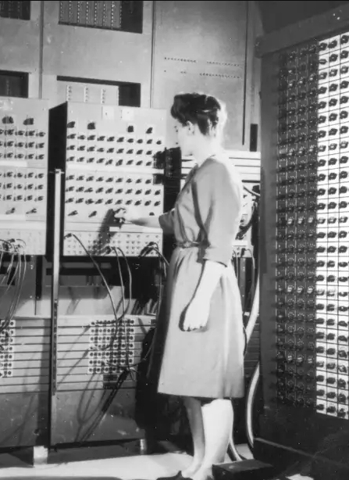
Early History
The first programmable general purpose computer was the ENIAC (Electronic Numerical Integrator and Calculator), developed by John Mauchley and J.Presper Eckert at the University of Pennsylvania.
It performed decimal arithmetic.
It took 2,800 microseconds to multiply two 10-digit decimal numbers… about 360 operations per second. (Desktop computers today are at least 1 billion times faster)
It was delivered to the US army in 1945 and was used to computer artillery trajectories.

Slide 4
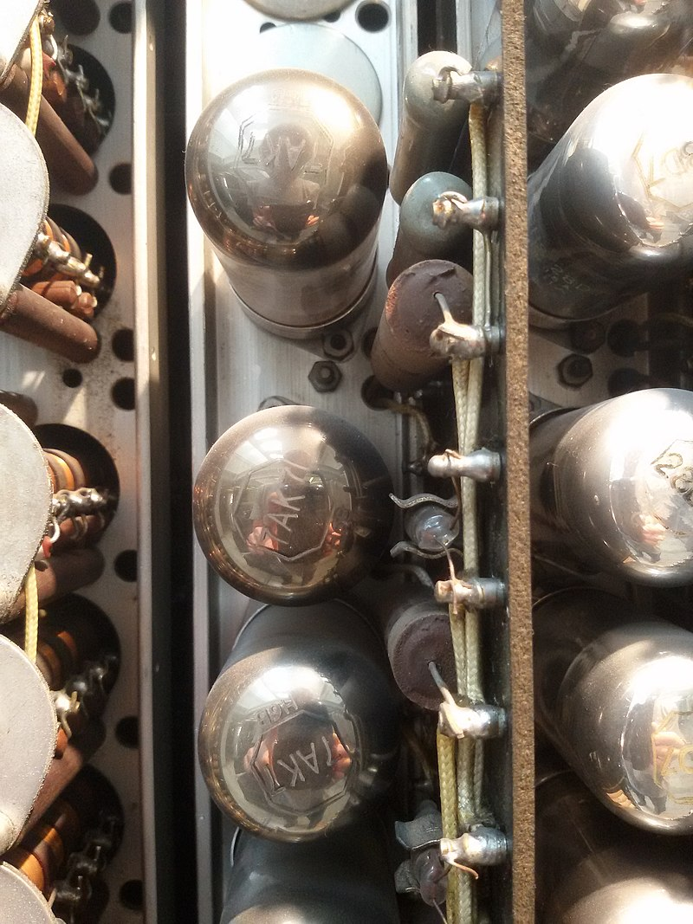
Early History - Continued
ENIAC was followed by the Univac (UNIVersal Automatic Computer), the first successful commercial computer, in 1951.
The Univac also used decimal arithmetic.
The Univac had 1000 words of 12 characters each. An integer was represented as a + or – character, and 11 digit characters.
These machines used vacuum tubes, which frequently burned out. They were “down” about 50% of the time.

Slide 5
Early History - Continued
The ENIAC, UNIVAC, and other early computers used decimal arithmetic. Rather than representing numbers in binary, they represented numbers as a string of decimal digits, each digit encoded in binary (BCD).
They had no provision for fixed point decimal or floating point numbers. If calculations involved non-integer numbers, the program needed to keep track of the decimal point independently.

Slide 6
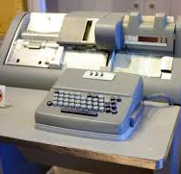
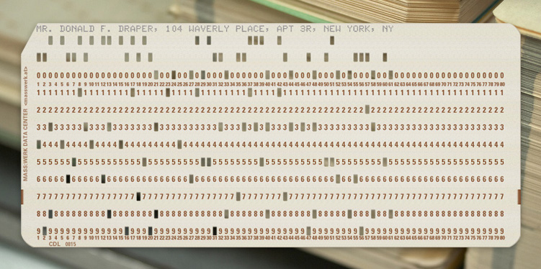
Early History – Why Decimal Arithmetic?
Comfort factor
Numbers were entered as decimal; conversion was expensive
Conversion caused rounding errors

Slide 7
BCD Arithmetic Today
Decimal, or Binary Coded Decimal (BCD) arithmetic is still important:
It is required for some languages, such as COBOL
Ideal for financial computations, where conversion errors can be a problem. $0.01 = 0.0000001010001111011 (binary) 0.0000001010001111011 = $0.0100002288818359375
Integer, fixed-point, and floating point BCD arithmetic is supported in hardware on some processors.
Other systems implement BCD arithmetic in software, via a library.

Slide 8
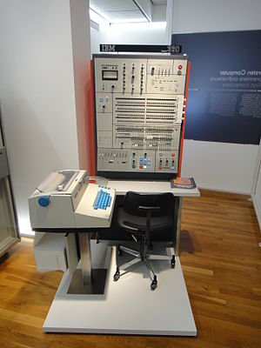
Binary Computers
The first binary computer, the Z1, was developed in the 1930s, but was unreliable.
The first widely successful binary computer was the IBM System/360, released in 1965.
It supported binary integer and binary floating point arithmetic, as well as decimal arithmetic.
It used a 32-bit word, which could hold four 8-bit characters.

Slide 9
Mini- and Micro-Computers
The 1960s and 1970s saw the development of mini-computers (really just small, inexpensive computers) and micro-computers (based on single-chip CPUs).
Mini-computers typically used 16-bit words, consisting of two 8-bit bytes. They supported multi-word formats for long integer and floating point arithmetic.
Micro-computers, which appeared in the mid-70s, often used 8-bit words, but had the ability to do 16-bit arithmetic and 32-bit arithmetic.
Integers were represented as 15 bits, plus a sign bit (+/- 32,767). Double-word integer arithmetic.

Slide 10
Precision and Portability
In order for programs to be portable across platforms (hardware independent), arithmetic must work the same on any hardware.
Language standards and test suites usually specify a minimum range and precision for each data type… but some systems support greater range and precision.
A program may run correctly on a high-precision system, and fail when run on a lower precision system – even though both systems are standards-compliant. The programmers are inadvertently depending on higher precision than the standards.
Some programs may even fail when running on higher-precision hardware.

Slide 11
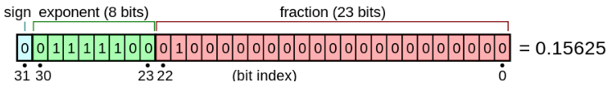
Floating Point Arithmetic
IEEE 754: a set of standards for binary and decimal floating point representation and arithmetic. The standard was established in 1985 and updated in 2008 and 2019.
Each sub-standard specifies the number of bits (digits) and the exponent size.
binary32: 24 significant bits (including sign); 8 exponent bits

Slide 12
Floating Point Arithmetic - continued
A floating point format consists of:
a base (also called radix) b, which is either 2 (binary) or 10 (decimal) in IEEE 754;
a precision p;
an exponent range from emin to emax, with emin = 1 − emax for all IEEE 754 formats
Specified representations for +infinity, -infinity, and NaN (not a number)
The IEEE 754 floating-point standard also includes rules for rounding

Slide 13
Character Sets and Portability
A character set is an encoding scheme for strings of text glyphs.
Character sets are generally not tied to processor hardware.
Character sets are tied to peripherals.
Processors may have instructions for character set conversions.

Slide 14
Character Sets – ASCII (/ˈæski)
ASCII (American Standard Code for Information Interchange)
7-bit ASCII (aka US ASCII): 0-127 - 1963
First 32 characters were reserved for control functions
Uppercase and lowercase English alphabet; 10 digits; punctuation and special characters (! @ # $ % etc)
Some programs used the 8th bit for other purposes!
8-bit (Extended) ASCII: 0-255
Adds many special and international characters: € † ™ £ ¶ Á á ä
Initially proprietary (system dependent)
ISO 8859 (ISO-8) defined several standard variants: Latin-1 (Western European), Latin-2 (Central European), Latin-3 (South European), Latin-4 (North European), Latin/Cyrillic, Latin/Arabic – 1987, 1999

Slide 15
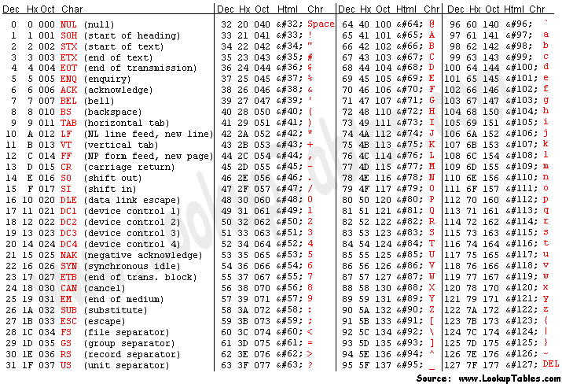
7-Bit ASCII

Slide 16
Character Sets – EBCDIC (/ˈɛbsɪdɪk/)
EBCDIC: Extended Binary Coded Decimal Interchange Code - the “other” 8-bit character set
Devised in 1963 for IBM mainframe computers and peripherals
Encompassed BCD decimal characters
ASCII and EBCDIC each contain characters not found in the other – such as “{“ and “}” - making translations ambiguous and language support difficult
Characters in EBCDIC are not in continuous alphabetical order, leading to potential portability issues: for (c='A';c<='Z';++c)
Steps through 26 characters if the character set is ASCII
Steps through 41 characters if the character set is EBCDIC

Slide 17
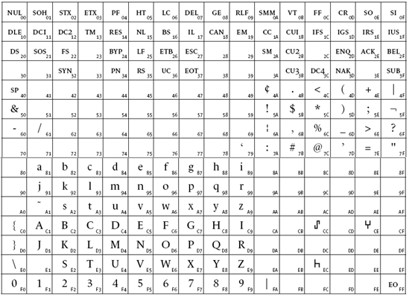
EBCDIC

Slide 18
Character Sets – Unicode
Unicode: unique, unified, universal encoding. An attempt to encode all of the world’s character sets.
Unicode currently supports 137,994 glyphs and control characters.
First draft standard was developed by Xerox and Apple in 1987.
First complete standard was adopted in 1991.
Actually a family of encoding standards: UTF-8, UTF-16, UTF-16BE, UTF-16LE, UTF-32, etc.
UTF-8: an 8-bit variable-width encoding which maximizes compatibility with ASCII; used by 94% of all sites on the web
One byte for characters 0-127; up to 4 bytes for extended characters

Slide 19
Instruction Set Architecture
Elements of Machine Instructions
Notes:
Let’s talk about history.
California State Railroad Museum – 1976 - docents worked on original steam engines.

Slide 20
Memory Addressing
Memory
Instructions and data are stored in memory
Memory is external to the processor
Accessing memory takes a significant amount of time
Registers
Built into the processor
Fast to access
Limited in number
Used directly by machine instructions: SBA 12 – (subtract 12 from the A register)

Slide 21
Addressing Modes
Immediate SBA 12
Register ADA B
Opcode Operand
- OR -
Opcode
Operand
Register
Opcode Register ID
Operand

Slide 22
Addressing Modes - continued
Direct LDA inventory
Memory Location
Opcode Address
Operand
- OR -
Opcode
Memory Location
Address
Operand

Slide 23
Addressing Modes - continued
Indirect – Useful for arrays LDA index*
Implied (Infinite) Indirection
Memory Location
Memory Location
Opcode Address
Memory Address
Operand
Memory Location
Memory Location
Opcode Address
1 Memory Address
1 Memory Address
Memory Location
Memory Location
1 Memory Address
0 Operand

Slide 24
Addressing Modes - continued
Register Indirect
Register Indirect with Auto-increment/Auto-decrement
The register value is incremented or decremented after the memory fetch
Useful for fast processing of lists or arrays
Register
Memory Location
Opcode Register ID
Memory Address
Operand

Slide 25
Addressing Modes - continued
Register Offset LDA array,X
Opcode Reg ID Offset
Register
+
Memory Location
Address
Effective address
Operand

Slide 26
Addressing Modes - continued
Using Register Indirect or Register Offset with Auto-increment/Auto-decrement
Easy in assembly language
Point register to list or array
Perform operations as register is incremented
Difficult for compilers! while (*from != ‘\0’) *to++ = *from++;

Slide 27
Addressing Modes - continued
Relative or PC (Program Counter) Relative JMP loop
Typically used for branch or conditional branch instructions
Opcode Offset
PC
+
Memory Location
Address
Effective address
Operand (next opcode)

Slide 28
Addressing Modes - continued
*** Stack Addressing ***
Stack Addressing with Auto-increment
Top of Stack
Opcode
Operand

Slide 29
Addressing Limitations
16-bit addresses limit memory to a “flat” space of 65,536 (64K) words or bytes of memory.
Segmented or bank-switched memory.
Memory is divided into 64K segments; a segment ID and an address are resolved to a physical (or virtual) memory location by the Memory Management Unit (MMU).

Slide 30
Addressing Limitations – Extended Base Register
Displacement or Base Register
Opcode Reg ID Offset
Register
+
Memory Location
Address
Effective address
Operand
Register > 16 bits
Effective Address > 16 bits

Slide 31
Addressing Limitations – Base Multiplier
Displacement or Base Register
Opcode Reg ID Offset
+
Register
Memory Location
Base * 2^{n}
Address Base
Effective base
Effective address
Operand
Register = 16 bits
Effective Base > 16 bits
Effective Address > 16 bits

Slide 32
Impacts on Programming
Multiple, complex addressing modes and memory management have made assembly language programming more difficult
Compilers, linkers and loaders need to be much smarter than their early counterparts

Slide 33
The Natural Evolution of Processors
Memory was very limited - ~ 1,000 words or less
Most programmers were writing in machine code or assembly language
By adding instructions that did more, programs required fewer instructions, and programmers didn’t have to write as much code
This led to what we now call Complex Instruction Set Computers (CISC)
Over time, instruction sets grew more and more complex.
Harder for hardware designers to implement
Slower (more “cycles” required for complex instructions)

Slide 34
Microprogrammed Instruction Sets
Complex instruction sets are very complex and hard to implement with logic design.
Microprogramming is a way of implementing instruction sets by writing lower level instructions for a microcontroller… a processor inside the processor.
Instructions are written in a microassembler language.
Multiple microinstructions to implement one machine instruction
Microinstructions are very low level: basic arithmetic and logic operations; register, memory, and bus access.

Slide 35
Microprogramming History
The first microprogrammed machine was the EDSAC 2, developed by Maurice Wilkes at Cambridge in 1958.
The instruction sets at the time did not require microprogramming
There was not practical and cost-effective way to build a persistent microcontrol store
The first widely successful microprogrammed computer was the IBM System/360, released in 1965.
Microprograms may be stored in ROM, or in EPROM to allow instruction set updates.

Slide 36

The Rise of RISC
In 1980, David Patterson at UC Berkeley outlined an architecture for a Reduced Instruction Set Computer, and coined the term RISC.
Fellow of the ACM
Fellow of the IEEE
Fellow of the Computer History Museum
ACM Distinguished Service Award
ACM-IEEE Eckert-Mauchly Award

Slide 37
RISC versus CISC
Reduced Instruction Set Computer
One clock-cycle per instruction
Effective pipelining
Fewer addressing modes
Requires more instructions per program (more RAM)
Lower gate count
Lower energy use
Complex Instruction Set Computer
Multiple / variable clock-cycles per instruction
More addressing modes
Requires fewer instructions per program (less RAM)
Higher gate count – more chip real estate
Higher energy use

Slide 38
RISC Versus CISC Today
No longer one versus the other
RISC and CISC architectures have borrowed from one another
Both are used
RISC
MIPS, PowerPC, Atmel’s AVR, the Microchip PIC processors, Arm processors, RISC-V
Often used in mobile devices and for embedded applications
CSIC
Motorola 68000 (68K), the DEC VAX, PDP-11, Intel x86

Slide 39
Instruction Pipelining (RISC computers)
Each instruction is divided into several steps or stages – allowing instruction execution to be overlapped. Example: 5-stage pipeline
Clock Cycle | Inst 1 | Inst 2 | Inst 3 | Inst 4 | Inst 5 | Inst 6 | Inst 7
1 | Fetch
2 | Decode | Fetch
3 | Execute | Decode | Fetch
4 | Memory Write | Execute | Decode | Fetch
5 | Register Write | Memory Write | Execute | Decode | Fetch
6 |  | Register Write | Memory Write | Execute | Decode | Fetch
7 |  |  | Register Write | Memory Write | Execute | Decode | Fetch

Slide 40
Instruction Pipelining - continued
Problems
Branch instructions break the pipeline, and it must be reloaded
Pipelines can be broken by interrupts
Data dependencies occur when an instruction relies on the results of a previous instruction, causing the pipeline to block
Advances
More stages… faster clock time, shorter blocks
Parallel pipelines for conditional branch instructions

Slide 41
New Directions
Heterogeneous computing: including multiple different computing elements (Application Specific Integrated Circuits, or ASICs) in a single system.
Graphics Processing Unit (GPU): common today
Machine learning
Image Processing
Cryptography
Video compression/decompression
Field Programmable Gate Arrays (FPGAs)

Slide 42
New Directions - continued
Near Memory Computing: reducing the need to time-consuming fetch and store operations
Rather than fetching small bits of data from memory to bring to the processor for computations, researchers are flipping this idea around. They are experimenting with building small processors directly into the memory controllers on your RAM or SSD.
By doing the computation closer to the memory, there is the potential for huge energy and time savings since data doesn't need to be transferred around as much.
This idea is still in its infancy, but the results look promising.

Slide 43
Quantum Computing
Commercial computing started with Binary Coded Decimal arithmetic.
Binary arithmetic allowed problems to be solved in different ways. It is faster the BCD, but has some problems.
Quantum computing promises a significant new paradigm for computation.

Slide 44
Quantum Computing - continued
Quantum computing is based on QUBITS – elements that can hold the value 0, 1, or some combination. This is called superposition.
Another quantum property is entanglement, in which the value of one element is tied to another.
Finally, quantum interference allows elements to affect the value of other elements – either positively or negatively. This leads to “voting” type solutions.

Slide 45
Quantum Computing - continued
Quantum computing offers the promise of simplifying certain classes of problems, including:
Modelling of natural systems
Searching
Machine learning
Artificial intelligence
It would be a mistake to say quantum computers are faster than conventional computers. Rather, they will solve certain types of problems much faster – and possibly solve problems that can’t be solved at all today.

Slide 46
Quantum Computing Today
The largest quantum computers are about 50 Qubits.
Two companies – Microsoft and IBM – have quantum simulators and development toolkits available.
Current computers are subject to quantum decoherence, which causes loss of state information.
Quantum computing algorithms need to be fault-tolerant

Slide 47
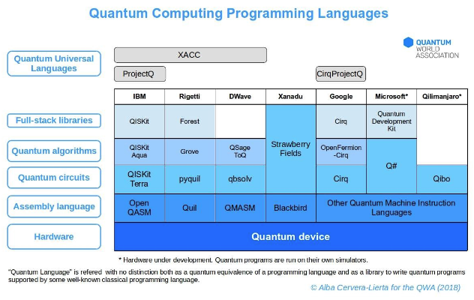
Quantum Computing Today - continued
New programming languages and libraries are being developed, but these languages are not yet standard. We are once again faced with portability issues.

Slide 48
Next Lecture
Simplified Instructional Computer
A “typical” computer instruction set

